Slide 1


Predicting breast cancer
Module 3 by: Payam Abbasi
Date: 08/24/20
Program: ds-pt-030220

Slide 2
The Deliverables
01
02
03
Jupyter Notebook
Readme.md
POWERPOINT PRESENTATION
04
05
A BLOG POST
Video walkthrough

Slide 3


What is breast cancer?
benign
malignant
not cancerous
cancerous
80% of biopsies
20% of biopsies
Breast Cancer occurs as a results of abnormal growth of cells in the breast tissue commonly referred to as a Tumor. The most common type of breast cancer starts in the ducts.

Slide 4

Facts About Breast Cancer In The United States
Although rare, men get breast cancer too. The lifetime risk for U.S. men is about 1 in 1,000
Breast cancer is the most common cancer in American women, except for skin cancer
There are over 3.5 million breast cancer survivors in the United States

Slide 5

Problem Statement
To analyze which features are most helpful to classify whether the breast cancer is benign or malignant.

Slide 6



methodology
Data Processing
Data Modeling
Model Evaluation

Slide 7
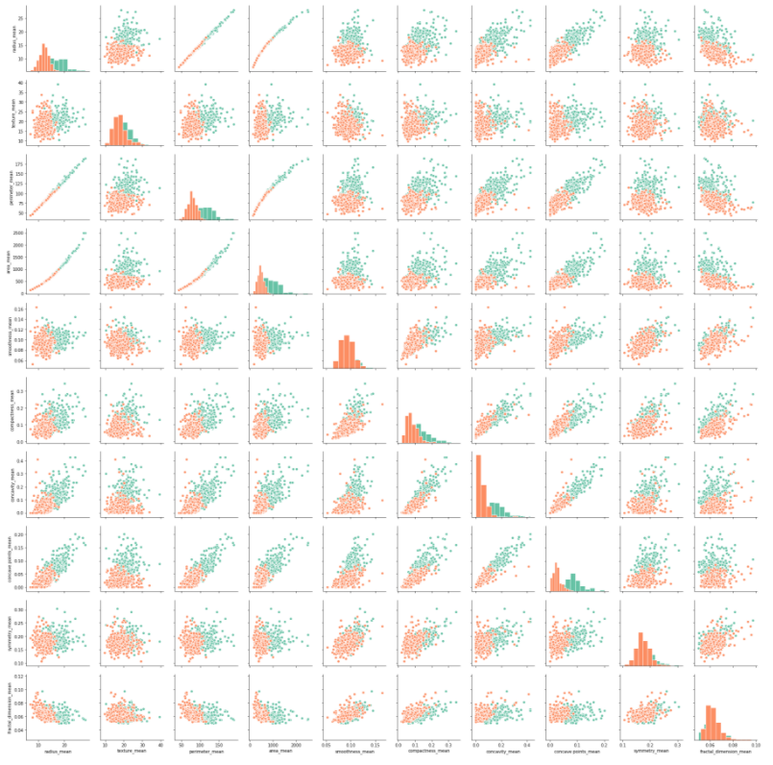
correlation
Overall analysis confirm there is a strong correlation between the mean variable and the diagnosis.

Slide 8
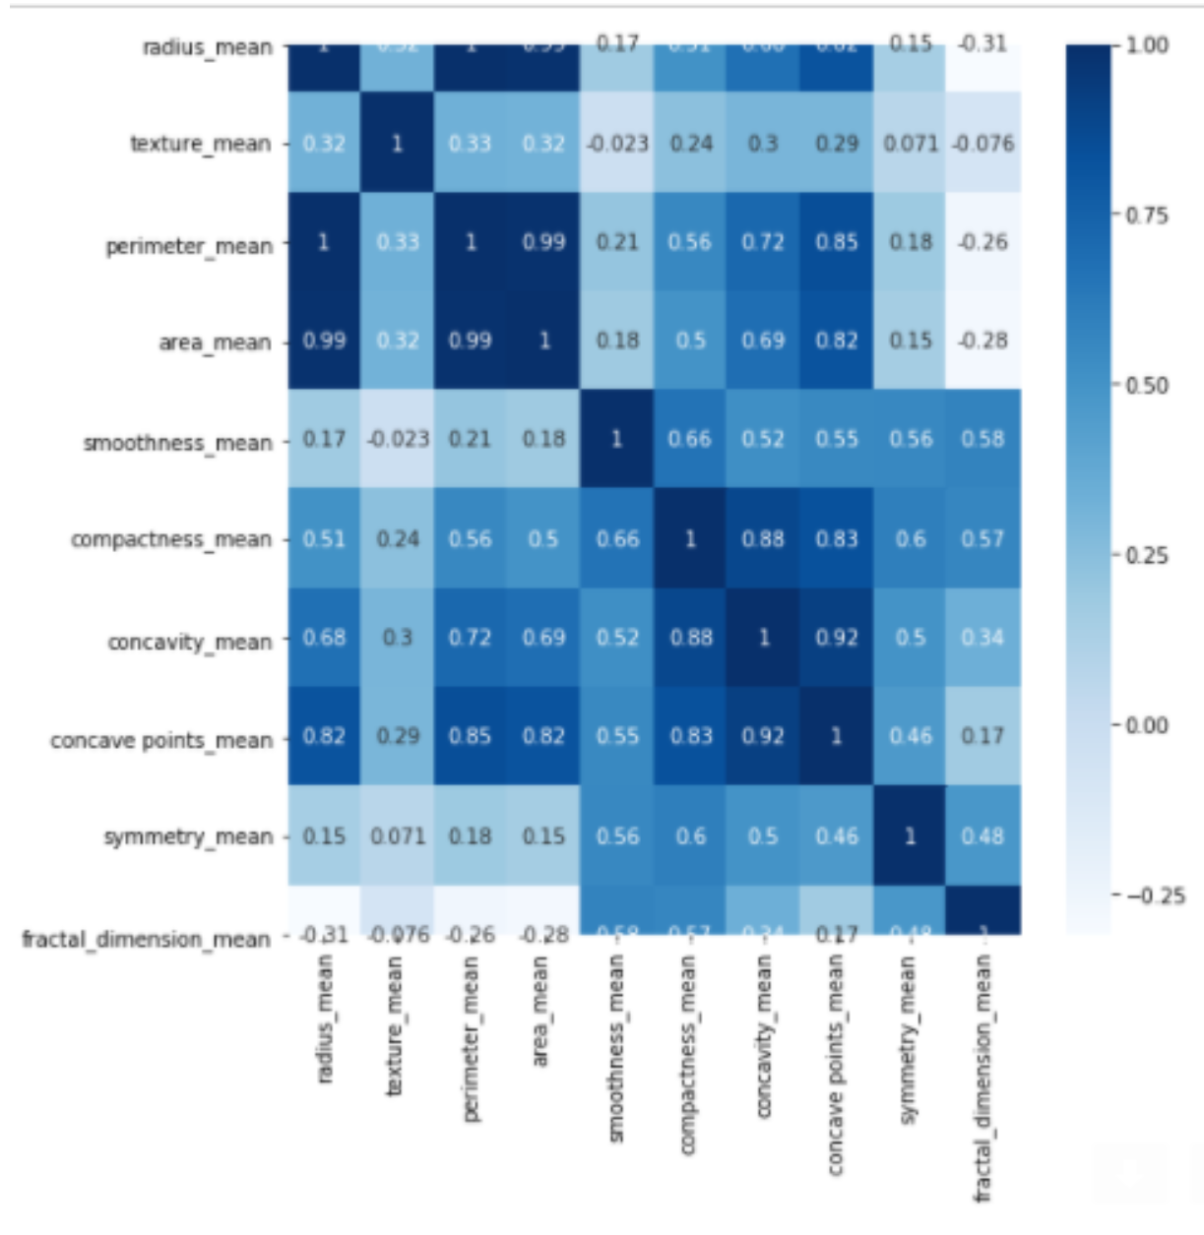
Important feature
As shown on the graph, the areas that are presented as darker cells confirm the strong correlation:
There are very strong correlations
between the following:
Radius
Parameter
Area
Compactness
Concavity
Concave points

Slide 9
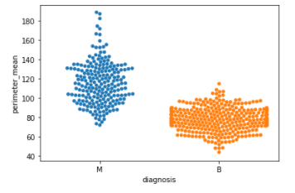
Bivariate Exploration

Slide 10
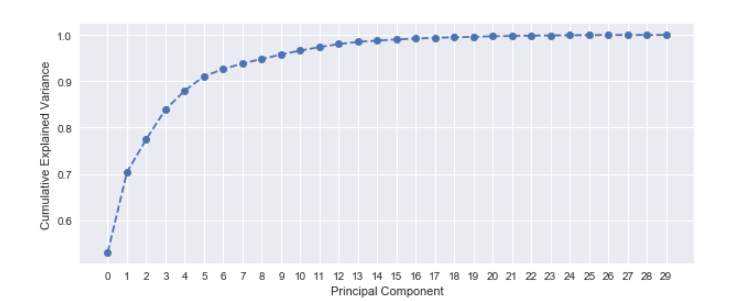
Principal component analysis (pca)
Running PCA to reduce complexity of dataset:
Our results confirmed 5 principal components are required to explain more than 90% of
the variance.

Slide 11
Recommendations
The feature analysis show that there are few variables with more predictive value for the diagnosis. Using PCA, we confirmed there are 5 variables that can be used to ensure explain the variance of 90% of the dataset.
Future steps:
To provide additional analysis to figure out which variables provide the most accurate data.

Slide 12
Thank you

